Slide 1
Vitamin D Production
Student’s Name
Institution
Date

Slide 2
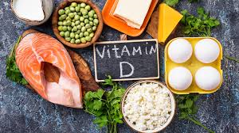
Introduction
Vitamin D is a fat soluble vitamin and a sterol
It also functions as a hormone (Goltzman et al., 2018).
The forms of vitamin D are in two categories:
Ergocalciferol (vitamin D2)
Cholecalciferol (Vitamin D3)
Notes:
Vitamin D is a fat soluble vitamin and also a sterol, which has a steroid nucleus known as cyclopentanoperhydrophenanthrene ring. It also functions as a hormone (Goltzman et al., 2018). Vitamin D is produced in two different forms; ergocalciferol (vitamin D2) and cholecalciferol (vitamin D3). Cholecalciferol is present in animals while ergocalciferol is in plants; however, both are provitamins, which are acknowledged as sources of vitamin D activity.

Slide 3
Function and Importance of Vitamin D
Biological function of regulating calcium and phosphorus
Helps in enhancing calcium absorption (Weller, 2017)
This enhances formation of strong bones
Decrease the risk of:
Autoimmune disorders
Cancer
Hypertension
Osteoporosis
Notes:
The primary biological function of vitamin D is enhancing the regulation of phosphorus and calcium. Vitamin D is also helps in the absorption of calcium, which enhances formation of strong bones (Weller, 2017). Researchers suggests that vitamin D protects people from developing diseases such as autoimmune disorders, cancer, hypertension, and osteoporosis. Vitamin D enhances the immune system to produce antibodies which are significant for developing immunity against different diseases.

Slide 4
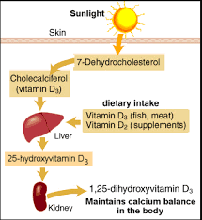
Production of Vitamin D
Vitamin D is recognized as a sunshine
7-Dehydrocholesterol is produced as an intermediate in cholesterol biosynthesis.
Exposure to sunlight converts 7-dehydrocholesterol to cholecalciferol in skin (epidermis and dermis) (Norman, 2012).
Melanin influences the production of cholecalciferol adversely.
Notes:
Vitamin D is recognized as a sunshine because its production is dependent on sunlight. In the form of cholesterol biosynthesis, 7-dehydrocholesterol is produced as the intermediate product. When an individual is exposed to sunlight, conversion of 7-dehydrocholesterol to cholecalciferol in the dermis and epidermis occurs (Norman, 2012). Skin pigmentation (melanin) influences the synthesis of cholecalciferol adversely.

Slide 5
Production of Vitamin D Continued…
Skin affects the production of vitamin D greatly.
The proportion of kin affects exposure to sunlight directly
Vitamin D production is inversely proportional to skin pigmentation (Norman, 2012).
Excessive exposure to sunlight does not lead to vitamin D toxicity.
Notes:
Skin is recognized to be the largest organ in the body. The production of Vitamin D is dependent on the exposure to sunlight; however, it is greatly affected by the increased pigmentation of the skin (Norman, 2012). Excessive sunlight exposure does not influence vitamin D toxicity. This is because excess D3 provitamins are damaged by the sunlight.

Slide 6
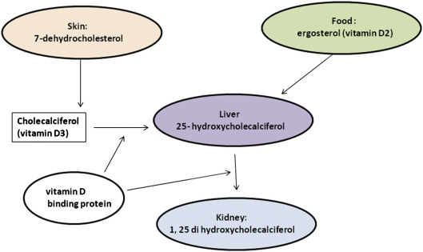
Metabolism and Biochemical Functions
Active form of vitamin D is 1,25 dihydroxycholecalciferol, also known as calcitriol
Hydroxylase in liver converts cholecalciferol to 25-hydroxycholeclciferol (Fleet, 2017)
Enzyme 25-hydroxycholecalciferol 1-hydroxylase is processed by the kidney
Notes:
The synthesis of 1,25-dihydroxycholecalciferol is the main process of vitamin D production since it is the active form of vitamin D. The process begins when cholecalciferol is hydroxylated by hydroxylase enzyme produced by the liver to 25-hydroxycholecalciferol (Fleet, 2017). The kidney produces an enzyme known as 25-hydroxycholecalciferol 1-hydroxylase.

Slide 7
Metabolism and Biochemical Functions Continued…
25-hydroxycholeclciferol is hydroxylated to 1,25 dihydroxycholecalciferol (1,25-DHCC) (Fleet, 2017)
1,25-DHCC (calcitriol) has 3 hydroxyl groups
The process enhances vitamin D production.
Notes:
Enzyme 25-hydrocholecalciferol 1-hydroxylase enhances the production of 1,25 dihydroxycholecalciferol (1,25-DHCC). 1,25-DHCC has 3 hydroxyl groups and is also known as calcitriol (Fleet, 2017). The process enhances vitamin D production, which is in the active state and ready for use in the body.

Slide 8
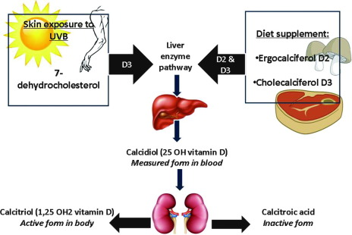
Metabolism and Biochemical Functions Continued…

Slide 9
Regulation
Regulation is influenced by blood phosphate and calcium levels
This occurs through phosphaturic, parathyroid hormone and fibroblast like growing factor 23 (FGF23) (Norman, 2012).
Endocrine system is the center of regulation
FGF23 enhances sodium-phosphate transport and decrease calcitriol level in serum
Notes:
The regulation of vitamin D in the body is influenced by the level of calcium and phosphate. Regulation involves phosphaturic, parathyroid hormone and FG23 (Norman, 2012). The endocrine system is involved in the regulation of vitamin D since it is also a hormone. Through FGF23, sodium-phosphate transport is enhanced, leading to the decrease in calcitriol level in the serum.

Slide 10
References
Fleet, J. C. (2017). The role of vitamin D in the endocrinology controlling calcium homeostasis. Molecular and cellular endocrinology, 453, 36-45.
Goltzman, D., Mannstadt, M., & Marcocci, C. (2018). Physiology of the calcium-parathyroid hormone-vitamin D axis. Vitamin D in Clinical Medicine, 50, 1-13.
Norman, A. (2012). Vitamin D. Elsevier.
Weller, R. B. (2017). The health benefits of UV radiation exposure through vitamin D production or non-vitamin D pathways. Blood pressure and cardiovascular disease. Photochemical & Photobiological Sciences, 16(3), 374-380.

